Slide 1
Prepared by the Living with Disability Research Centre
Frontline Practice Leadership: what it is and how to do it

Slide 2
Plan for Today
Learn what is Frontline Practice Leadership and why it is important
Learn what are the 5 tasks of Frontline Practice Leadership
Identify who does Frontline Practice Leadership in your organisation
Learn about quality of life and why it is important
Learn how to effectively allocate and organise staff support
10:00 to 3:30pm

Slide 3
Why is Frontline Practice Leadership Important?
latrobe.edu.au
Support workers directly influence the quality of life of the people they support.
Support workers - like staff in any organisation - need guidance, instruction and support to develop their skills and become competent.
How much guidance and instruction did you receive when you were a support worker?
It is the role of Frontline Practice Leaders to help support workers to develop and enhance their skills.
Strong Frontline Practice Leadership ensures staff provide good Active Support. If support workers provide good Active Support, then people with intellectual disabilities will experience a better quality of life.
We know from research that training staff in Active Support is often not enough for it to be successfully implemented and maintained in services. By using Practice Leadership, frontline supervisors can embed Active Support in services.
Notes:
What support workers do and how they do it matters to the lives of people with intellectual disabilities. ​

Slide 4
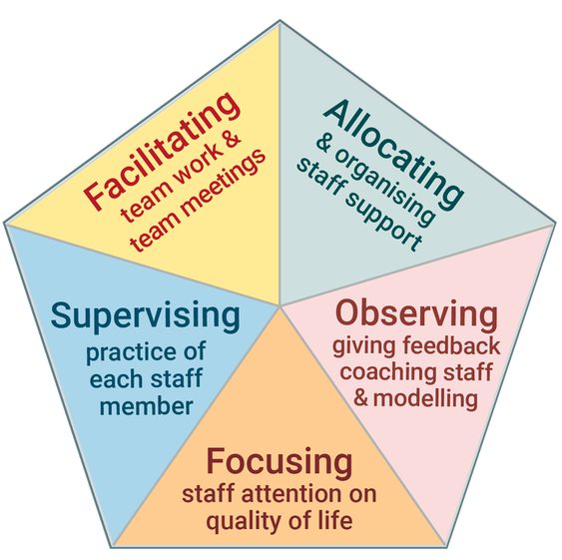
What is Frontline Practice Leadership?
latrobe.edu.au
Frontline Practice Leadership (FLPL) is the set of 5 tasks that are critical to ensuring good quality support for people with intellectual disabilities.
FLPL is a practical way of supporting staff to develop their skills and improve how they provide direct support to people with intellectual disabilities.
Mansell et. al. (2004) conceptualised practice leadership and the 5 tasks.
Practice Leadership is different from frontline management. It is about guiding practice, rather than managing procedural aspects of the service and staff.
Notes:
How have FLS learnt to perform their role – manage staff and the service?

Slide 5
The Five Tasks of FLPL
Focusing Staff Attention on Quality of Life: ​ensuring the primary focus of the service and staff is on the quality of life of the people you support.​
Allocating and organising staff: to work individually and as a team to deliver support when and how the people supported need and want it.
Observing staff, giving feedback, modelling and coaching good practice: to improve the quality of staff support.
Supervising the practice of each member: through deep and focused discussions about the support worker’s practice.
Facilitating team work and team meetings: to ensure staff support is consistent and to share knowledge and ideas about the people you support.
Notes:
The other 4 tasks provide ways of focusing staff on QOL
The 5 tasks are not separate but are interconnected
Focusing on QOL should be at the centre of the other tasks

Slide 6
Who is Responsible for the 5 tasks?
Staff responsible for the five tasks of Practice Leadership are not always called Practice Leaders.
Organisations have different titles for staff who do these tasks, such as:
Supervisor, frontline manager, team leader, service manager
Usually, it is the direct supervisor of support workers in a service who is responsible for the five tasks of Practice Leadership.
A supervisor may be responsible for one service, or across two or three services.
In some organisations, the tasks of Practice Leadership are divided between different staff.

Slide 7
Activity: the 5 Tasks of FLPL
Look at the five tasks of Practice Leadership and think about the service/s where you work:​
Which of the five tasks are you responsible for?​
If you are not responsible for all five tasks, who is responsible for the other tasks?
Which of the tasks do you think you are performing well?
Which of the tasks do you think you can improve?
In what ways is the service/s you manage performing well?
In what ways is the service performing not so well?

Slide 8
Organising FLPL
There is no one way of organising Practice Leadership.
Whoever does the five tasks of Practice Leadership needs to be close to the frontline and know the staff and the people they support well.
Where the tasks of Practice Leadership are split between different staff they need to work together to share information and coordinate their work.

Slide 9
Summary: What is Frontline Practice Leadership
Frontline Practice Leadership involves influencing service delivery and staff practices so that people with intellectual disabilities experience good quality of life.
Practice leadership → leading staff practice
Practice leadership consists of five tasks

Slide 10
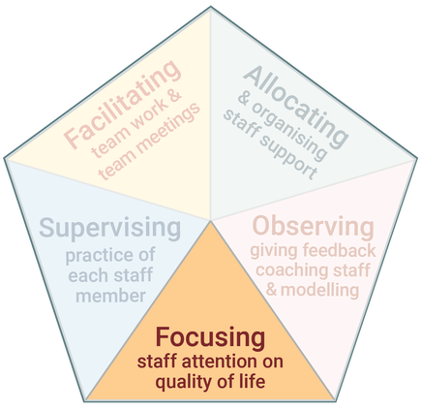
Focusing Staff Attention on Quality of Life
Ensuring the primary focus of the service and staff is on the quality of life of the people you support.​

Slide 12
Applying a Quality of Life Framework
Helps you to focus on each individual and what is important to them
How good is their quality of life? Helps you to identify how support can be delivered so that each individual experiences good quality of life
​ How well is the service supporting their quality of life?
Keep in mind when thinking about quality of life:
All 8 domains apply to everyone
What a good quality of life looks like is different for each individual
You need to know a person well to really understand what a good quality of life looks like for them

Slide 13
Service Type and Quality of Life
Some services focus on particular quality of life domains whereas others focus broadly across all domains:
A community access service may have greater influence on social inclusion, interpersonal relations, and domains specific to the aims of each individual.
An employment service may have greater influence on the domains of personal development, material well-being and social inclusion.
Group homes are likely to focus on and influence each of the domains.

Slide 15
Activity
What was identified as important to Michael’s quality of life?
Use the 8 domains of quality of life and their indicators in your workbook and think about a person you support: What would the person identify as important to their quality of life?
Think about the service and supports this person receives: In what ways do they contribute to the person’s quality of life?
In what ways could the service and support be improved so the person experiences better quality of life?

Slide 16
Focusing Staff Attention on Quality of Life​
Staff support is a key influence on the quality of life of people with intellectual disabilities.
Frontline Practice Leaders must help staff to understand that the support they provide makes a real difference to a person’s quality of life.
How can Frontline Practice Leaders do this?
You may need to explain to staff what quality of life is, and that the purpose of the service and their role is to enhance the quality of life of each person they support.
You may need to demonstrate to staff how to support a person to engage in an activity or social interactions
For some staff, understanding this may be a challenge because they have other ideas about the purpose of the service and their role. Or they may underestimate a person’s potential to be engaged or experience good quality of life.

Slide 18
Activity
How did the support worker (Sophie) see the purpose of her role?
How did the Practice Leader help the support worker to think about Maree’s quality of life?

Slide 19
Focusing Staff Attention on Quality of Life​
Activity Question: How did the support worker (Sophie) see the purpose of her role?
The support worker thought the purpose of her role was to complete chores and administration tasks, and keep Maree occupied.
It is not easy having a conversation with staff to shift their thinking and beliefs.
How did the Practice Leader help the support worker to think about Maree’s quality of life?
Asked “how meaningful is that for her?”, “What is her quality of life?” and “How can we support her better?”
Helped the support worker to think about what QOL and engagement looks like for Maree
Helped the support worker to recognise opportunities for engagement – applied some of the 4 essentials of Active Support to stimulate thinking
Provided suggestions for other activities

Slide 20
Summary: Focusing Staff Attention on Quality of Life
A task of Frontline Practice Leadership is to give clear and strong messages to staff about the aspects of their work that are most important and should take priority.
Enhancing quality of life needs to be the priority.
The other four tasks of Practice Leadership are used to help staff focus on quality of life.

Slide 21
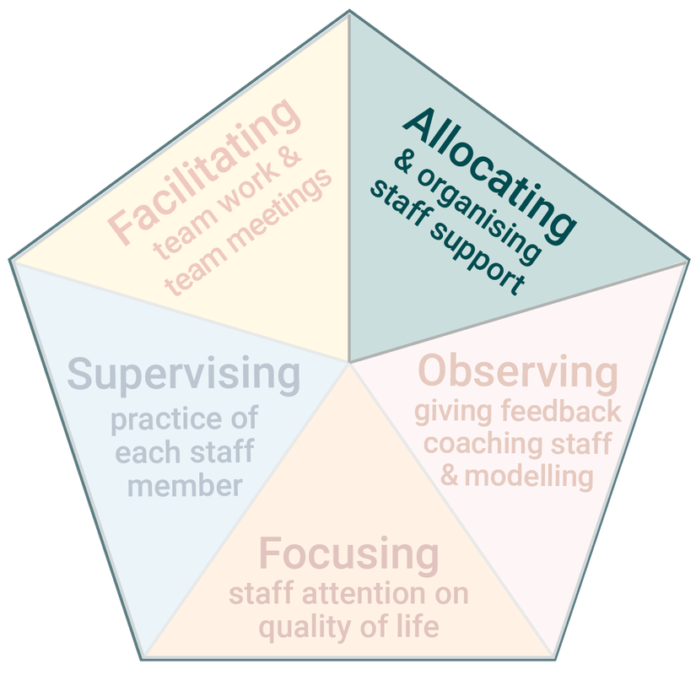
Allocating and Organising Staff Support
Frontline Practice Leaders organise and support staff to work individually and as a team.
This helps ensure:
Staff support is provided when and how each person you support wants and needs it
Consistency across staff in the way they work and provide support
Staff resources are used effectively

Slide 22
Key Elements of Allocating and Organising Staff Support
Frontline Practice Leaders ensure:
Shift plans are written and used – capture information about the regular patterns of activities and behaviour in a service
Staff plan before and during shifts – staff need to work out the key activities that will happen and who will be responsible for them
Staff plan with the people they support – find out what they want to do and plan their day with them

Slide 23
Shift Plans: Organising What Staff Do Each Shift
Staff need to know what they are expected to do on each shift, how to provide support, and how to work with other staff, if there are any on shift. ​ Shift plans communicate this information to staff.
Shift plans capture information about the regular patterns of activities that occur in a service on a daily and weekly basis.
In accommodation services, they should include key information about the regular activities of each person supported:
personal and self-care activities
Ieisure, social and educational activities
domestic and household activities
community based activities
contact with family and friends
appointments

Slide 24
A Good Shift Plan
Provides information about the sequence of events that is likely to happen
For example, a morning shift plan indicates what time each person usually wakes in the morning, what they do once they get up, when they eat breakfast, when they attend to their personal care and so on
Provides information about the support needs of each person and how to support them
Focuses on the people you support first and then staff tasks
7 to 7:30am: Jo makes her breakfast. Jo will choose her breakfast – show her some options. Jo makes her breakfast with verbal prompts from staff
Guides staff in how they should organise their time on shift
Provides structure to the work staff do and the support they provide, but also allows for changes to routine based on the preferences of the people you support and what is happening that particular day

Slide 25
Activity: Shift Plans
Read the example shift plan in your workbook. What does the information tell you about the people and how to support them?
How does it compare with the shift plans in your service?

Slide 26
Shift Plans vs No Shift Plans​
Some staff may say that they don’t need shift plans because they have worked in the service for a long time and know what to do.
But the problem is the unspoken routine in the service may be more staff-centred than person-centred.
Staff inconsistency can be an issue in services. There might be some staff who regularly support people to be engaged in meaningful activities but other staff who do not.
Shift plans are a good starting point for establishing consistency. They communicate expectations to staff about what should happen on shift and information about how to best support each person.

Slide 27
Advantages of having shift plans | Problems not having shift plans
​Helps staff know what to do on each shift and how to do it | ​What happens each shift, when and how depends on who is working, resulting in inconsistency across staff
​Helps staff prioritise and plan activities | ​Staff make decisions about how to use their time, which may not be in accordance with how each person you support wants and needs it
​Inform and remind staff of what the people they support do each day and how to support them | ​A lack of predictability for the people who receive support
​Provides a way for staff to record and share their knowledge about how to best provide support | New and casual staff have to learn for themselves how to work in the service and provide support
​Ensures each person receives support when they want and need it | ​Opportunities to regularly engage people in activities may be missed

Slide 29
Activity
What problems did you see with the way staff were organised in this scenario?
What impact did it have on each person who was being supported?
If you were the Frontline Practice Leader in this service, what would you do to improve how staff were organised?

Slide 30
Poor Planning
What were the problems in this scenario?
Ineffective allocation of staff – Both support workers were working in the kitchen providing support to three people for one activity → Staff working on the same activities, rather than separate
No planning between staff – Staff providing uncoordinated support, one doing more work than the other
Extended moments of disengagement – Residents often watching the female worker, the person near the sink disengaged and did not want to cook, not enough opportunities in this activity for all three people to be engaged
Missed opportunities – To provide effective assistance to cut carrot, acknowledge the person who came into the kitchen, for people supported to be more involved and engaged
Notes:
What were the problems in this scenario?
There was ineffective allocation of staff. Both support workers were working in the kitchen providing support to 3 people for 1 activity.
Staff were working on the same activities rather than separate activities. Which was unnecessary in this case.
There was no planning between the two staff. This meant their support was not coordinated. One worker was doing more work than the other.
The female worker organised the cooking, but the male worker was watching what was happening and wasn’t clear on what he should be doing.
The residents had extended moments of disengagement. They were often watching the female worker. The female resident standing near the sink was not engaged at times and did not want to cook. There were not enough opportunities for all 3 people to be engaged in the cooking.
There were also a number of missed opportunities. A male resident was not assisted effectively to cut the carrot. The other male who came into the kitchen was not acknowledged. Overall, they could have been more involved and engaged.
Towards the end, the staff starting chatting to each other which didn’t involve the residents.

Slide 31
What Happens When There is No Shift Planning?
Without planning among staff on shift there is potential for problems to occur:
​Staff working on the same activities as each other, rather than separate activities
Staff wandering around providing ad-hoc and uncoordinated support
Staff feeling that the workload is unfairly shared, which can lead to friction between staff
The people you support being disengaged

Slide 32
Planning Before and During Shifts
Shift plans help staff to plan what is likely to happen on their shift.
Having shift plans does not mean that staff need to follow a rigid routine.
What happens each shift will still change according to day-to-day changes in the lives of the people they support.
Staff who are working together need to plan together before and during the shift.
They need to work out the key activities that will happen and who will be responsible for them.
One way is to allocate staff to different areas of the house (e.g., kitchen, lounge room, bathroom) or activities (e.g., cooking, cleaning, leisure), rather than to specific individuals.
As the shift progresses, staff working together need to continually update each other and when required modify the plan.
You may need to facilitate and model planning before and during shifts until staff become comfortable doing it themselves.

Slide 34
Activity
What did the staff do differently in this scenario, compared to the previous scenario?
What impact did it have on each person who was being supported?
If you were the Frontline Practice Leader, how would you set the expectation that this way of planning and organising among staff needs to happen every shift?

Slide 35
Good Planning
Staff planned at the beginning of the shift – worked out the key activities that will happen and who will be responsible for them. The female worker is more experienced in this service and led the conversation.
Read the shift plan – the male worker read information about what is likely to happen and the support the people need and want
Allocated to areas/activities – male worker in the kitchen, female worker supporting a resident to complete a form at the dining table. This allocation allowed for more individualised support.
People supported how they want and need it – support provided to two residents who wanted to cook, staff provided assistance to perform activities, female resident supported to complete a form, male resident acknowledged when he enters the area
Staff updated each other during the shift – aware of what was happening, and no one was missed

Slide 36
Developing Shift Plans
Shift plans must include useful and relevant information.
They require time and effort to be developed.
There is no one way to make a shift plan. Each plan must be designed in a way that best communicates information.
Good shift plans strike a balance between providing too much and too little information. They should be easy to follow and act upon, and not take too long to read. You could use one document or several. See your workbook for an example.

Slide 37
Writing Shift Plans
There are various ways of writing shift plans. You could use one or a combination of the following:
​The Frontline Practice Leader can write it
One or more knowledgeable support workers can write it (e.g., a support worker who regularly works a particular shift)
Staff working on shift can jot down their main tasks and then combine this information
The Frontline Practice Leader or a support worker can ask the person/people you support for their input about their routine and how they like to be supported
The Frontline Practice Leader can collate and condense information already written about each person in their individual plans and discuss a draft plan with the staff team.

Slide 38
Reviewing Shift Plans
Once shift plans are drafted, they will need to be reviewed by staff who work in the service. You can ask individual support workers to provide comments or they can be reviewed collectively in team meetings.
Once developed, the shift plans will need to be regularly reviewed to ensure they are up to date and contain relevant information.

Slide 40
Planning with the People You Support
Part of shift planning is communicating to the people you support what their day will look like and planning it with them.
A plan of the day is one way of communicating to the person you support what they can expect will happen. Some services use pictured plans to represent the key activities for the day. See an example in your workbook.
In other services, staff spend time with each person on each shift to plan with them what will happen during the shift. The plan may be developed verbally, by writing it down, or using pictures.
7-9am: | Wake up, shower, wash my hair.
10am: | Go for a walk.
​12-3pm: | Go to the bank and shop. Buy lunch.
​5:30pm | Ring mum.
​6-7pm: | Make dinner.
​7-10pm: | Have a chat and watch TV.

Slide 42
Activity
What would it be like for the person receiving support in three different ways to make their coffee?
Imagine you are the Practice Leader in this service:
What would you do to establish consistency in how staff support this person to make his coffee?

Slide 43
Summary: Allocating and Organising Staff
Frontline Practice Leaders must organise and allocate staff so that each person receives the support they need and want.
They must ensure there are shift plans, and that staff plan before and during shifts, and with the people they support.
Having these things in place contributes to staff knowing what to do on shift, consistency across staff, and ensuring people are supported to engage in meaningful activities and relationships.

Slide 44
Recap
What is Frontline Practice Leadership?
Why is Frontline Practice Leadership important for staff and service delivery?
How can you use the QOL framework in your services?
What strategies can you use to help staff to focus on QOL?
What are the three main ways of allocating and organising staff support?
What are the benefits of having shift plans?
How can staff plan with the people they support?
What are the benefits of effectively allocating and organising staff support?

Slide 45
Prepared by the Living with Disability Research Centre
Frontline Practice Leadership: what it is and how to do it

Slide 46
Plan for Today
Learn how to observe staff and give them feedback, and how to model and coach to improve their practice
Learn about the different types of supervision and how to have effective supervision with staff.
Learn how to facilitate team meetings and team work
10:00 to 3:30pm

Slide 47
Recap: The 5 Tasks

Slide 48
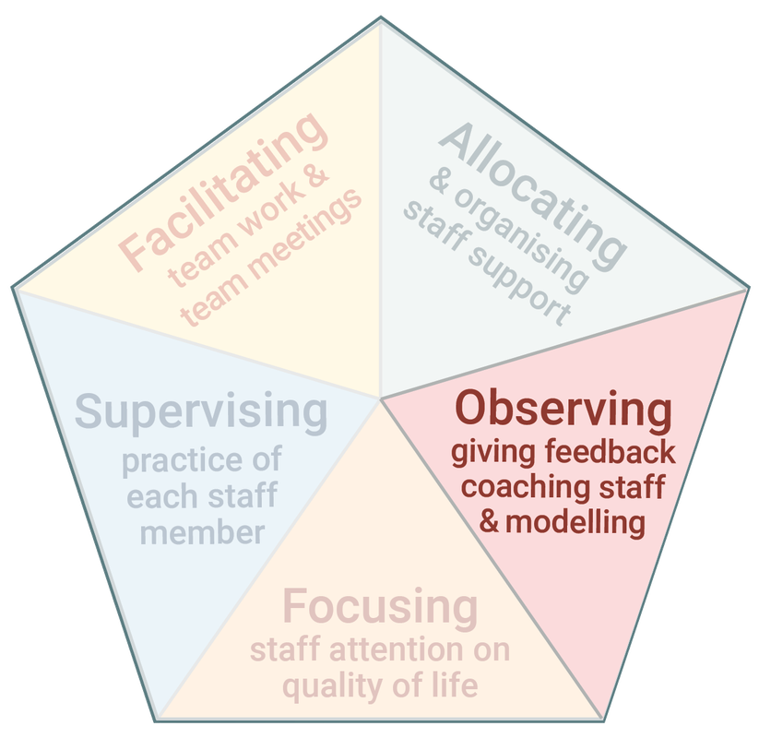
Observing Staff, Giving Feedback, Coaching and Modelling
By doing this task well, Practice Leaders help support workers to:
Develop new skills
Refine existing skills
Reflect on their practice
Receive new ideas and suggestions
Notes:
The next task of PL is observing staff and giving feedback, coaching and modelling
The aim is to help staff to be better practitioners.

Slide 49
Observing Staff
Means directly watching staff support and interact with a person.
It is the best way to identify good practice and areas for improvement.
What should Practice Leaders observe?
What is happening in the moment
The experience of the person or people being supported
The quality of staff support
There is a template to guide observations in your workbook.

Slide 50
Observing the 4 Essentials of Active Support
Are staff:
Using the moments of potential available for the people they are supporting to be engaged in activities?
Breaking activities into smaller parts and providing opportunities for participation?
Providing the right type and amount of assistance to ensure success?
Maximising choice and control by providing options, ensuring people understand what is on offer and tailoring their communication and support to the needs of each person?
Using little and often, if needed, by paying attention to how the people are engaging in the activity, whether they want to have a break and return to it again later?
It takes practice to be competent observing staff – knowing what to look for and paying close attention to what is happening. As you become more skilled you will be able to focus on all of these things at once.

Slide 51
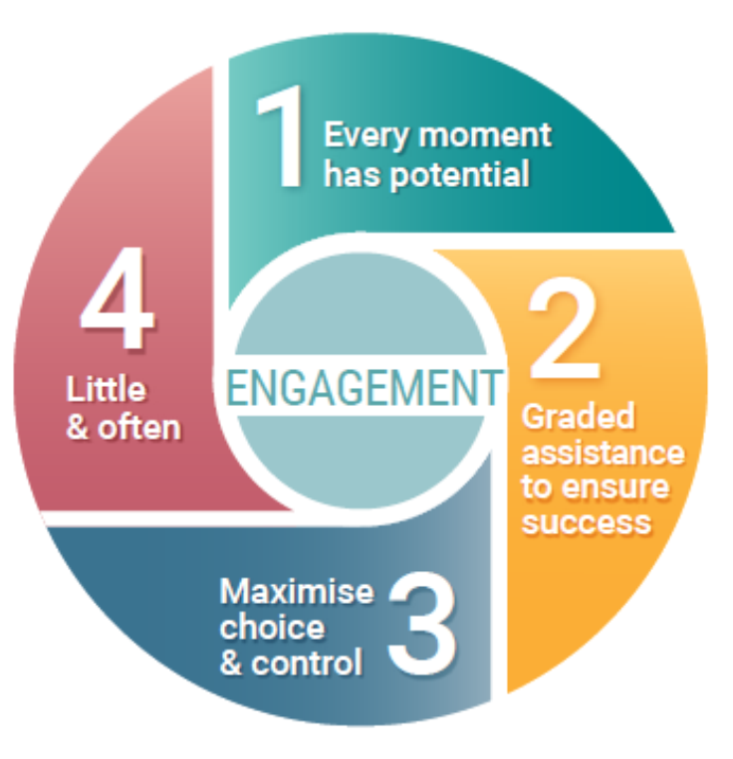
Activity
Watch the following video and make notes about the support you observe.
Use the template in your workbook and the 4 Essentials to guide your observation.

Slide 53
Value of Feedback for Support Workers
Feedback helps support workers to know how well they are performing.
It helps support workers to reflect on their practice and how it can be improved.
Feedback also motivates them by recognising and encouraging good support.
Notes:
Receiving feedback is beneficial for support workers.
It lets them know how well they are performing.
It helps them to reflect on their practice and how it can be improved.
And it motivates them by recognising and encouraging good support.
Notice that the language around observation and feedback is positive.
The aim is to help staff to develop their skills.
But in order for that to happen, PLs need to be skilled in providing feedback.

Slide 54
Thinking About Feedback
The purpose of observing staff is to provide them with feedback so they can develop and improve their support skills. The first step of providing feedback is planning. You need to reflect on what you observed and think about what you will say to the support worker.
To plan feedback, ask yourself these questions:
What is working well?
What is not working so well?
Was the level of assistance suitable?
Was the activity performed successfully?
Was the communication appropriate to the person being supported?
Is there a better way of providing support?
What would I have done differently?
What will I say to this staff member?

Slide 55
Activity
Look at the notes you made for the previous Activity.
​Plan your feedback to the support worker. Use the questions on the previous slide to guide your feedback.
What feedback would you provide to the support worker?

Slide 57
Activity
How did the Practice Leader provide feedback?
What was it like for the support worker?

Slide 58
Poor Feedback
How did the Frontline Practice Leader provide feedback?
Began by focusing on negatives and areas to improve.
Mostly used close-ended and “why” questions, which didn’t encourage a conversation or the support worker to reflect on her practice. Instead the support worker felt she had to justify what she did.
Did not offer the support worker an opportunity to speak about her perspective.
Was critical rather than developed the support worker’s practice.
Notes:
How did the PL provide feedback in this scenario?
He began by focusing on the negatives and areas to improve – that she could have set up the activity better.
The practice leader mostly used closed ended and why questions, which didn’t encourage a conversation or the support worker to reflect on their practice. Instead the support worker felt like she had to justify what she did.
The practice leader didn’t offer the support worker an opportunity to speak about her perspective and reflect on her practice.
He was quite critical of her practice.
Let’s consider the support workers perspective.
What did she get out of this feedback? What would have it been like for her?
Lets now see how the feedback could have been delivered better.

Slide 59
Tips for providing feedback
Find out the support worker’s point of view: start with an open-ended question, “How do you think that went?” Or “What was that like for you?”
Identify the positives: find something positive to say before focusing on problems. What did the support worker do well?
Be specific: use examples from your observation - what people said or did.
Use the language of Active Support: staff should be familiar with the 4 Essentials. Using this language reinforces expectations about the support they provide.
Encourage reflection: ask open-ended questions to help support workers reflect on their practice. For example, “What were the advantages and disadvantages of doing that?” “How do you think the person you supported responded to that approach?” “What might you do differently next time?”
Be constructive: give staff ideas and concrete examples about how to do things differently.
Be timely: give feedback as close to the event as possible.

Slide 61
Activity
How did the Practice Leader provide feedback in the scenario?
What was it like for the support worker?
What were the differences between the way feedback was provided in this and the previous scenarios?

Slide 62
Good Feedback
How did the Frontline Practice Leader provide feedback?
Found out the support worker’s point of view: started with an open-ended question, “How do you think that went?” and “What did you think of the support you provided?”
Identified the positives: support worker’s effective communication – reinforces what the person did well.
Was specific: used specific examples about what happened and the support provided.
Encouraged reflection: invited the support worker to speak about the issue she raised and asked open-ended questions to encourage reflection. “What could be a more effective way of supporting Hayley?” Gave the support worker an opportunity to problem solve.
Used the language of Active Support: graded assistance, little and often.
Was constructive: gave the support worker ideas and suggestions about how to do things differently → to give Jo a rest from painting and chat with her and the others (i.e., it’s not just about the activity of painting)
Notes:
In this scenario, the practice leader began by finding out the support workers point of view. He asked open ended questions, such as How do you think that went? What did you think of the support you provided?
He identified the positives. That the support workers communication was effective. Identifying the positives reinforces to the support worker what they did well.
The practice leader was specific. He identified examples about what happened and the support provided.
He encouraged reflection. He invited the support worker to speak about the issues she raised and asked questions.
Such as What could be a more effective way of supporting Hayley? This gave the support worker an opportunity to problem solve.
He was constructive. Towards the end of the discussion, after listening to the support worker and identifying the positives, he provided ideas and suggestions about how to do things differently.
This PL is someone who has knowledge and skill. He provided some practice advice so that the support worker can improve how she provides support.
Let’s consider what it was like for the support worker?
In the previous video she was frustrated, her point of view was not considered and she was on the receiving end of criticism.
This time she had an opportunity to speak and get her point across, the feedback was positive and constructive, and she received encouragement and advice.
Imagine if support workers regularly received this types of feedback and encouragement.

Slide 63
Observing Patterns of Support Over Time
When you conduct regular observations, you will see patterns in the way individual staff and the team provide support. Understanding these patterns helps you to identify where they are performing well and any inconsistencies.
Is the support worker more skilled in some aspects of support than others?
Is the support worker better at supporting one person than another person?
Patterns across the team members:
Is the support provided to an individual consistent across all team members or does each staff member provide support in a different way?
Does one person frequently receive more opportunities to engage in activities than others?
Do team members provide too much or too little support for a particular individual?
Are there regular missed opportunities for engagement?
Are people supported to engage in only a limited range of activities and why is this the case?

Slide 64
Modelling good practice
Modelling is demonstrating behaviour and skills so that staff can see and learn how to provide good support. There are two ways that Frontline Practice Leaders model practice:
​Passive modelling happens all the time. You must be aware that staff watch and learn from you when you interact and provide support.
Active modelling is instructing staff to watch you provide support to show them a new or better way of providing support.
What is the problem with relying on modelling to influence staff behaviour?
Notes:
Frontline Practice Leaders constantly model practice because staff are watching how you behave and interact.
You need to demonstrate exemplary practice. However, you cannot rely on modelling alone to influence staff behaviour.
Staff have to interpret your behaviour and they may not always understand why you behaved in a particular way. Other ways of influencing staff behaviour are also needed. We have already talked about giving feedback and we discuss coaching in the next section.

Slide 65
Coaching
Coaching means instructing a worker how to provide support and guiding their practice.
A coaching session includes the following steps:
Determine the support worker’s skill level by observing them and asking questions
Demonstrate how to provide support, explain the steps and give advice
Observe the support worker providing the support you have demonstrated
Provide feedback, answer questions and if needed provide further demonstration and advice
Once the support worker has learnt the skill or its basic elements, develop with them a plan to practice it
​​
Coaching sessions should occur when opportunities arise and also be scheduled on a regular basis for each staff member in your team.
Notes:
The process is similar to how a music teacher instructs a student to learn a new song or skill.

Slide 67
Activity
Think about a support worker who would like, or would benefit, from coaching.
Plan how, when and where you would provide coaching to this support worker.
Think about how you would use the above steps to provide coaching to this support worker.

Slide 68
Using Videos in Coaching
Having staff watch and comment on their own practice can help them to identify good practice and areas to improve.
With permission, you can record videos of staff practice using mobile phones or tablets, and then use them for coaching purposes.
You can show videos of good support with staff in team meetings or supervision. This can be a learning tool for staff and used to create consistent support in the service.
You must ensure confidentiality of those you film.

Slide 69
Activity
Watch the following video and make notes about the support you observe.
What feedback would you provide to the support worker and how would you provide it?

Slide 71
Summary
By observing staff and giving feedback, Frontline Practice Leaders can help staff to further develop their practice.
It is important to know what to look for and how to effectively provide feedback.
Frontline Practice Leaders use modelling and coaching to demonstrate and teach staff how to provide good support.
The aim of this task of FLPL is to share your knowledge and skills with staff, so they become better practitioners.

Slide 72
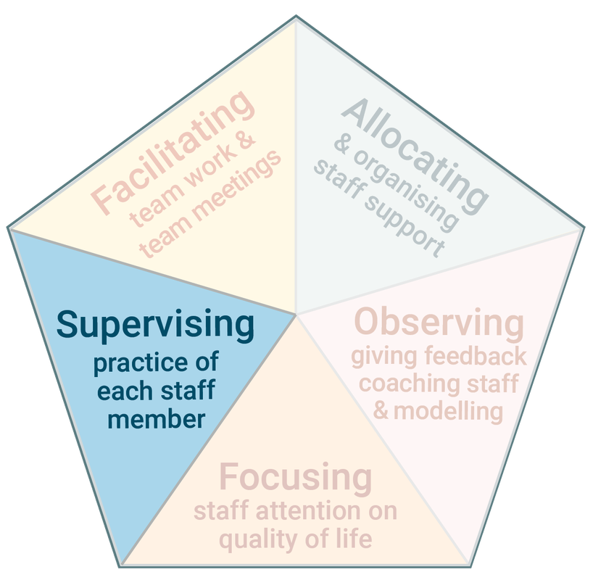
Supervising Practice of Each Staff Member
Supervision means the Frontline Practice Leader and a support worker have a deep and focused discussion about the support worker’s practice.
Supervision guides and develops the support worker’s practice.

Slide 73
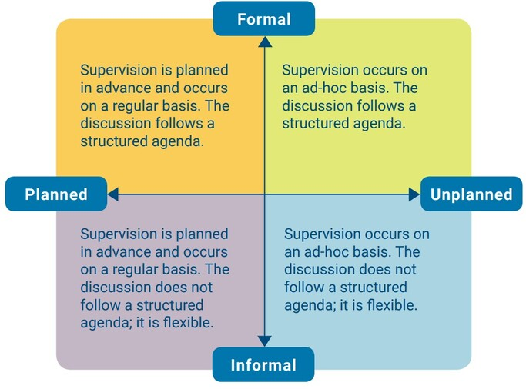
Types of Supervision
Notes:
We focus on Planned formal and Unplanned informal in this training

Slide 74
Activity
What type of supervision do you most frequently have with staff?
How well is this type of supervision meeting the needs of staff?
Is there another type of supervision that you are currently not using which would be beneficial for staff?
How could you make use of this type of supervision?

Slide 75
Planned Formal Supervision
Frontline Practice Leaders:
review staff performance
acknowledge good Active Support practice
encourage staff to think critically and reflect on their practice
help staff to identify areas of their practice for improvement
​discuss issues and problem-solve
discuss key workers responsibilities, expectations and strategies for implementing person centred plans
build rapport with individual staff
Each organisation has policies about the regularity, time allocated and format of planned formal supervision.
Notes:
Ideally, it should occur with each staff member on a monthly or 6-weekly basis.

Slide 76
Conducting Supervision
A good planned formal supervision session should:
Have clarity of purpose for the meeting and what will be discussed
Create a supportive, reflective and safe space
Identify ways the staff member is working well
Identify Active Support skill development needs
Develop an action plan or review progress against goals identified in the plan.
If there are performance concerns that need to be discussed, it’s best to:
Describe the concern using examples of specific behaviour and explain its adverse impact
Avoid accusations or insults that focus on personal characteristics
Adopt a problem-solving approach that canvasses ideas from the staff member

Slide 78
Activity
What was discussed in the supervision session in the video?
How did the Practice Leader direct the conversation and help the support worker to reflect and problem solve?

Slide 79
Asking Questions
The success of supervision depends on communication skills. The way you ask questions and listen are important for conducting effective supervision.
Think carefully how you phrase questions. You want to gather information and generate discussion.
Open-ended questions are best. These questions begin with ‘how’ or ‘what’.
E.g., “What have you been working on?” and “How do you think you are going?”
They invite the support worker to speak.
Questions that start with ‘why’ can imply blame or that something has gone wrong, so are often best avoided.
Questions that just need a ‘yes’ or ‘no’ response should be used sparingly because they do not encourage discussion (except when followed up with an open-ended question).

Slide 80
Ineffective Questions | Effective Questions
​Why are you having this problem? | Can you explain the problem? What challenges are you experiencing?
​Why did you do it that way? | What was your approach? Can you explain your approach?
Did that work? | ​What happened when you tried that approach? What was the outcome?
​Why didn’t that approach work? | ​What were the advantages and disadvantages of that approach?
Why did he do that? | ​How did he respond?
​He didn’t like it, did he? | ​​What was it like for him?
Notes:
Ineffective questions rephrased more effectively

Slide 81
Listening
Active – giving full attention to the staff member, interpreting what they are saying and checking that you have understood.
Open – having an ‘open mind’ that suspends any preconceptions or judgement. Being open lets the staff member work through an idea, explore an issue, or explain a problem.
Notes:
It involves paying attention to what is being said, how it is said and accompanying body language, interpreting what has been said and checking that you have understood accurately. If you are focusing more on what you want to say when it is your turn to speak, or you think you know how to solve a problem before hearing it fully, then these could be signs you are not really listening

Slide 83
Activity
How did the Practice Leader use the skills of asking questions and listening in this conversation?
Think about where you work. When and how often are there opportunities for unplanned informal supervision with the staff you manage?

Slide 84
Supervision Skills
What skills did the Frontline Practice Leader use in this supervision?
Asked open-ended questions –The FLPL asked: “How are you going supporting Paul at lawn bowls?”, “How so?”
Listened Actively – the FLPL gives the support worker her full attention, nods and says “uh huh” to indicate she is listening, and she summaries the topic to ensure she has understood correctly and to move the conversation forward – “So what you’re saying is…”.
Listened Openly – the FLPL listens to the support worker describe the problem and then continues to ask questions to fully understand the problem. For example, “Can you tell me what happens when you get to lawn bowls?”
Reinforced good support – identifies where the support worker performed well.
Problem solved with the support worker
Provided a suggestion after fully understanding the problem – The FLPL shares with the support worker her knowledge and expertise to help develop the support worker’s practice.
Notes:
What skills did the Frontline Practice Leader use in this supervision?
The PL asked open ended questions. Such as How are going supporting Paul at lawn bowls? And a follow up question of How so?
These types of questions are useful for gathering information and generating discussion.
She listened actively. The practice leader gave the support worker her full attention, nods and says uh huh to indicate she is listening.
She summarised the topic to ensure she understood correctly and to move the conversation forward.
The practice leader listened openly – she asked questions and listened to the support worker so that she fully understood the problem
She reinforced good support by identifying where the support worker performed well.
They problem solved together.
The practice leader provided a suggestion only after fully understanding the problem. She shared her knowledge and expertise with the support worker to help develop his practice.

Slide 85
Activity: Conduct a supervision session
Work in pairs - one person is the supervisor and the other is supervisee – and conduct a supervision session.
Supervisor, help the supervisee to:
reflect on how they are going in providing Active Support
identify where they are working well and can improve
identify goals and a plan to improve practice
Use the skills of asking effective questions, active and open listening
Once done, switch so that each person has a turn as the supervisor and supervisee.
Notes:
About 10 minutes each.
At the end ask, what was it like being the supervisee?
What was it like being the supervisor?

Slide 86
Summary: Supervision
Frontline Practice Leaders need to have regular planned formal supervision with staff and recognise and use opportunities for other types of supervision.
Conducting supervision with staff is a skill.
Supervision needs to focus on staff practice and quality of life.

Slide 87
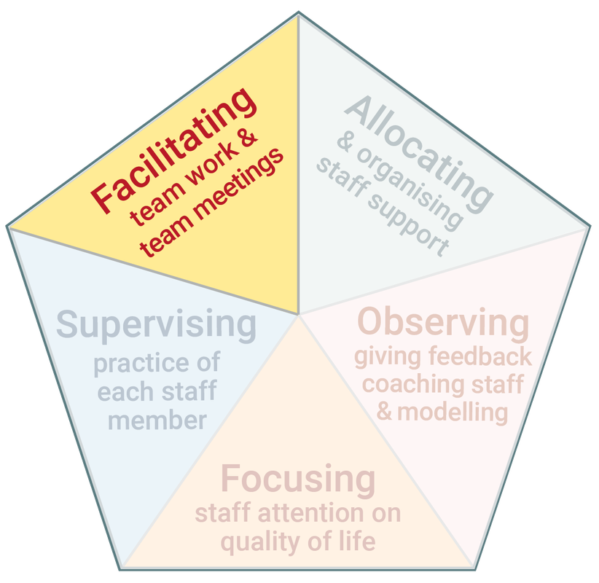
Facilitating Team Work and Team Meetings
Frontline staff in disability services work in teams.
Team members have to work together, communicate, interact and problem solve collectively to achieve common goals.
Team meetings enable these things to happen.
Notes:
Do you have regular team meetings in your services? What do you talk about in team meetings?

Slide 88
Team Meetings are used to…
Review and discuss the quality of life of each person you support, by asking how is their quality of life, how could it be improved, what support is required?
Develop team members’ skills in Active Support by sharing ideas and examples of good practice.
Establish consistency across staff by sharing information about the best way to provide support and agreeing how support will be delivered.
Share information and problem solve by discussing what staff have tried, what has and hasn’t worked, and learning from each other.
Clarify key objectives and expectations in the service.
Shape team culture
Enhance peer relationships

Slide 89
Preparing for Team Meetings
Before the meeting prepare the agenda.
Ensure the agenda reflects the priorities for improving the quality of life of the people you support in this service.
Tips for preparing an agenda:
​Be clear what you want to achieve in the meeting. E.g., generate new ideas about enhancing a person’s quality of life and share examples of good practice.
Work out how you will achieve your aim for the meeting. E.g., how will you encourage staff to share examples of their practice?
Allocate time for each item to make sure you have sufficient time to discuss everything on the agenda.
Review minutes from the previous meeting and note topics that should have been followed up.
Review notes from observations and supervisions and look for patterns across team members.
Circulate the agenda to team members before the meeting so they can also prepare and invite them to add additional items.​

Slide 90
Chairing the Meeting
Effective team meetings rely on a skilled chairperson:
Create an atmosphere where everyone feels comfortable in contributing to the discussion and that their opinions are valued.
Control the flow of the meeting by keeping the group on task and to time.
Strategies for chairing effective meetings include:
Encouraging discussion by asking open-ended questions
Ensuring everyone has a say by asking each staff member to have input
Respecting everyone’s opinion by listening to what they have to say
Ensuring everyone is following the discussion by summarising key points as the conversation progresses
Identifying when the discussion moves substantially off topic and bring it back on track

Slide 92
Activity
How did the Practice Leader chair the team meeting and direct the discussion?
How did the Practice Leader generate input from staff?
What do you think of how team members interacted with each other?

Slide 93
Chairing a Team Meeting
How did the Frontline Practice Leader chair the meeting?
Focused the discussion on a person they support (Sam) and his quality of life
Encouraged discussion by asking open-ended questions – E.g., “What household tasks has he been doing this past month?”
Encouraged sharing of information – asked a support worker to share information about how to support a person to make breakfast
Established consistency across staff – asked all staff to start providing support to Sam to make breakfast using the same support
Set expectations – that all staff provide this support and if they don’t get all the tasks done in the morning it is okay, let other staff know
Ensured everyone had a say by asking each staff member to have input – got input from all team member’s about community activities that Sam might enjoy
Respected everyone’s opinion by listening to what they have to say
Delegated responsibility – asked one support worker to update shift plans and another to follow up community activities
Ensured minutes of the meeting were being recorded
Notes:
How did the Frontline Practice Leader chair the meeting?
She focused the discussion on one person and his QOL.
She encouraged discussion by asking open ended questions.
She encouraged staff to share information. For example, a support worker was asked to share information about how to support a person to make breakfast.
She helped to establish consistency by asking them to all support Sam to make his breakfast in the same way.
She set the expectation that staff work in this way and if they don’t get all the tasks done it’s okay and to let other staff know.
The practice leader ensured everyone had a say by asking each staff member to have input.
She listened to everyone and respected their opinion
And she delegated responsibility.

Slide 94
Focusing on Practice and Quality of Life in Team Meetings
Staff practice and the quality of life of the people you support need to be the main focus of team meetings.
Some suggestions to do this are:
Pick one QOL domain and discuss how well each person you support is doing on this domain
Brainstorm ideas for improving each person’s QOL and what support would be needed
Focus on one of the people you support and review their QOL across all 8 domains
Review one of the 4 Essentials of Active Support and how it is used with each person you support
Give feedback on the team’s performance based on your observations, coaching and supervision
Review together videos of staff providing support to identify good practice and areas to improve
Ask staff to share one success story each in relation to a person you support
Organise staff to work in small groups on a problem, then come together to share ideas

Slide 95
Minutes
Minutes are the record of the meeting and agreed actions.
Write the minutes from notes taken during the meeting and circulate as soon as possible after the meeting.
Minutes should include a summary of key points discussed, decisions, actions and who will be responsible for them.

Slide 96
Characteristics of Team Culture
Better performing services | Poorer performing services
Strong leadership – the FLPL sets expectations, leads practice and provides staff with feedback | Individual or groups of staff try to exert leadership of other staff, undermining the FLPL
Team members share the same values about their work, including prioritising the quality of life of the people they support | Team members have different values, which do not necessarily reflect those of the organisation
Team members share responsibility for the quality of life of the people they support | Lack of shared responsibility among team members – each member has their own set of priorities
The quality of Active Support is consistent across staff | The quality of Active Support is very inconsistent across staff
Staff feel that they are part of the organisation they work for and the local community where they work | Staff feel distanced from, and distrust, the organisation they work for
Staff are open to new ideas and want to make positive changes | Staff are resistant to change and want to preserve the status quo

Slide 97
Activity
Reflect on the team you lead and respond to these questions:
What are the key characteristics of the staff team?
How do the characteristics compare with those in the table above?
In what ways is the team culture positive? In what ways could it be improved?

Slide 98
Summary: Facilitating Teamwork and Team Meetings
Team meetings are an opportunity for staff to discuss the quality of life of each person they support and identify ways it could be improved.
They are an important opportunity for staff to collectively discuss Active Support.
For team meetings to be effective, they must be well planned, skilfully chaired and provide a place for staff to think together and share ideas.

Slide 99
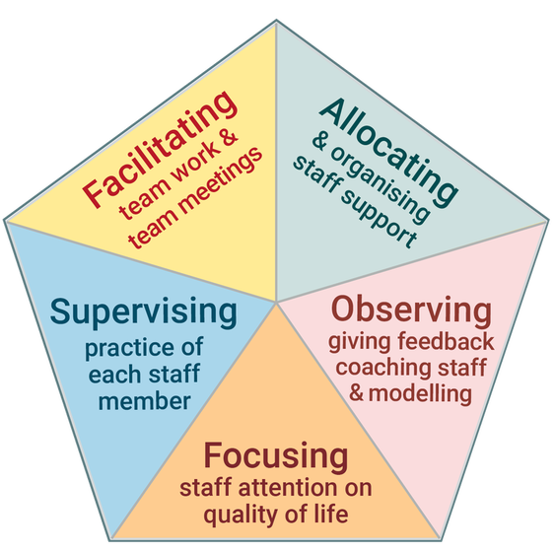
The 5 tasks are Interconnected

Slide 100
Activity: Overcoming Difficulties
On day 1 of the training in the first activity, you were asked:
Which of the tasks do you think you are performing well?
Which of the tasks do you think you can improve?
In what ways is the service/s you manage performing well?
In what ways is the service performing not so well?
Now, using what you have learnt about Frontline Practice Leadership, how can you:
Enhance the ways you or the service are performing well?
Address the areas you or the service can improve?

Slide 102
Recap
What should you look for when observing staff provide support?
How do you provide effective feedback?
What are the two types of modelling?
What does coaching involve?
What are two types of supervision?
What contributes to effective supervision?
What are some strategies for effective team meetings?

Slide 103
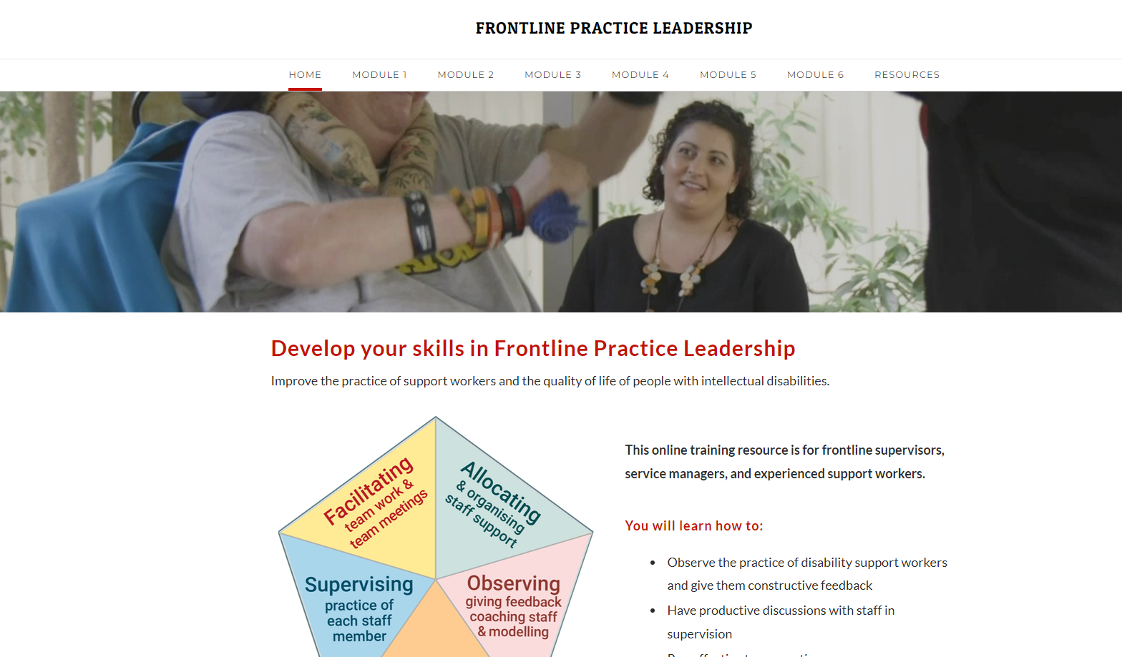
Further Resources
https://www.practiceleadershipresource.com.au/

Slide 104
Thank
You
Living with Disability Research Centre
http://www.latrobe.edu.au/lids
Email: Lids@latrobe.edu.au

